Slide 1
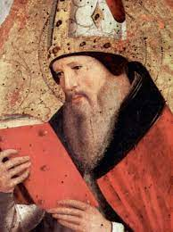
The Easter Triduum
St Augustine speaks of
‘the three days of Christ crucified, buried and risen’

Slide 2
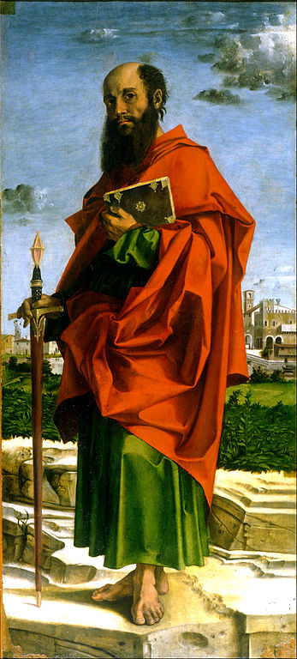
St Paul
1 Corinthians 11
V.23 I received from the Lord what I passed on to you. That on the night he was betrayed the Lord Jesus took bread
V.24 and having given thanks he blessed it and said: This is my body which is for you. Do this in memory of me.

Slide 3
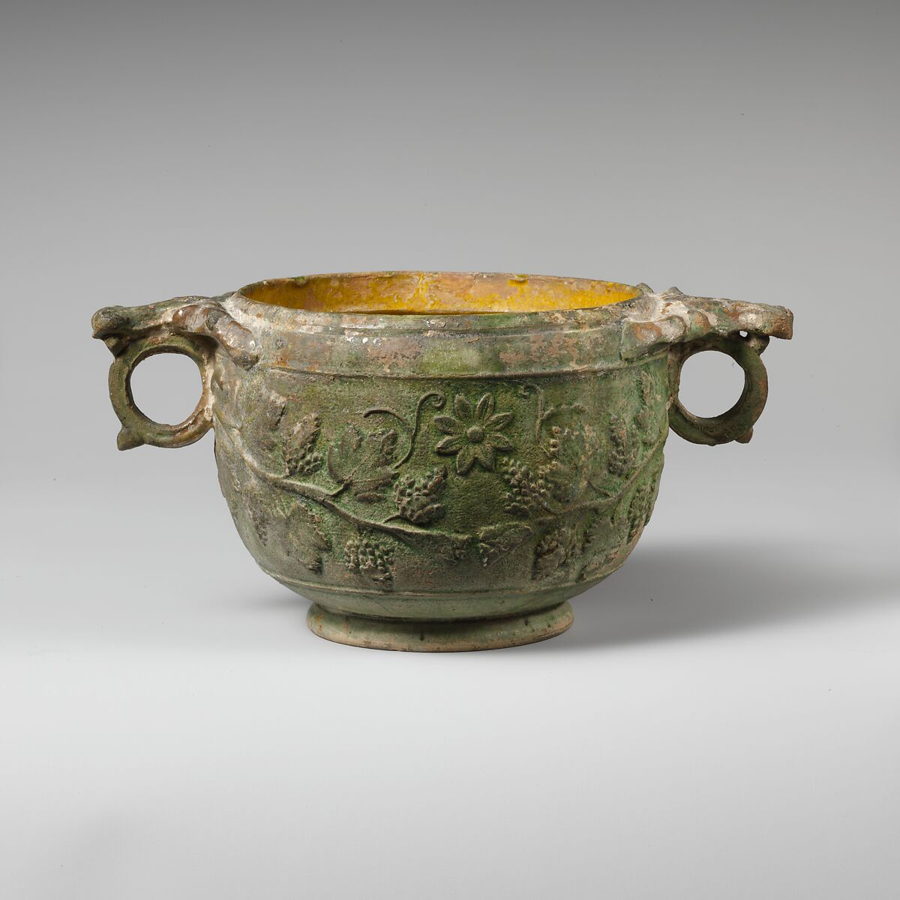
1 Corinthians 11
V.25 The same with the cup after the supper, he said This cup is the new covenant in my blood. Do this, as often as you drink it, in memory of me.
V.26 As often as you eat this bread, and drink this cup, you proclaim the death of the Lord until he comes.

Slide 4
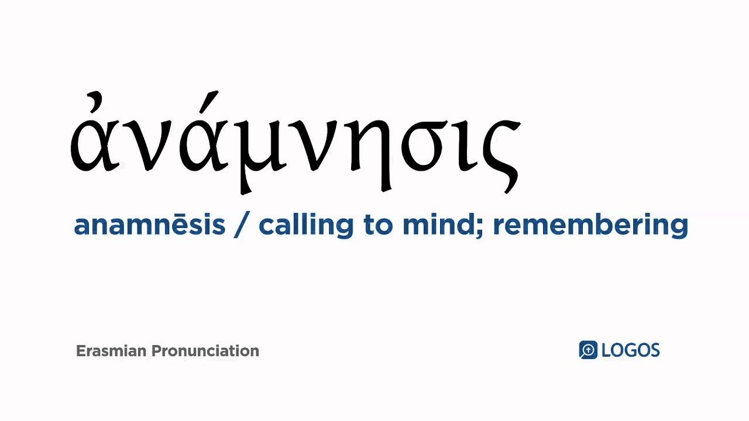

Slide 5
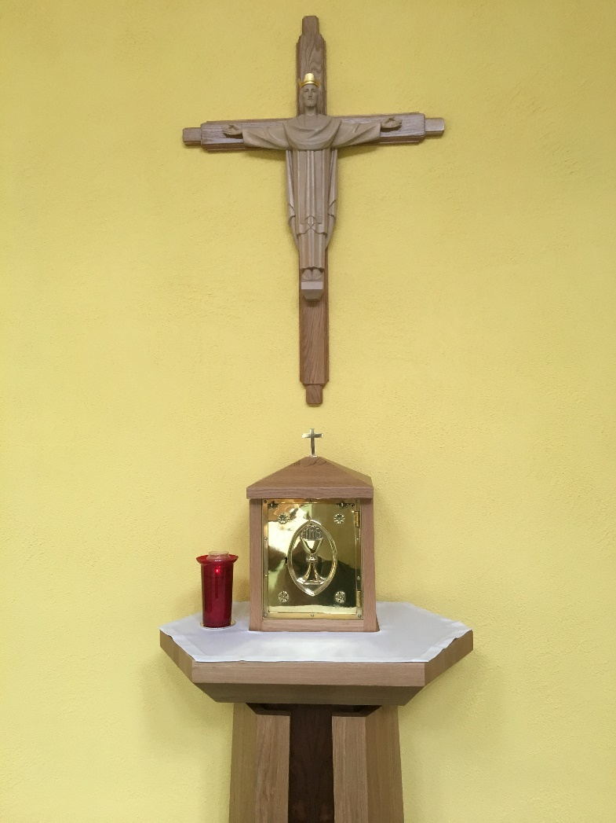
Christ our High Priest
The Letter to the Hebrews says:
‘We have a high priest who is both trustworthy and compassionate.’ (2:17)
‘He offered himself once and for all for us.’ (7:27)

Slide 6
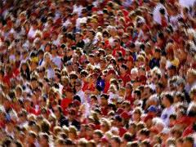
Acts of the Apostles 2:42
Three thousand were baptised.
They remained faithful to
    the teaching of the apostles
    the community
    the breaking of bread
    the prayers

Slide 7
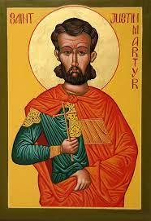
St Justin Martyr: First Apologia 66 (c.155 AD)
It is called ‘Eucharist’.
It is for those ‘who believe that the things which we teach are true’.
It is ‘for those who have been washed with the washing that is for the remission of sins, and for regeneration’.
It is not ‘ordinary bread’ or ‘ordinary drink’.

Slide 8
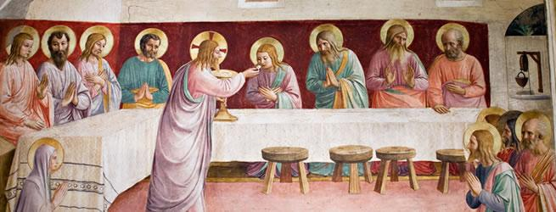
The Last Supper: First Apologia 66
The apostles, in their Gospels, tell us that Jesus took bread, gave thanks, and said Do this in memory of me. This is my body. In the same way he took the cup, gave thanks and said: This is my blood.’

Slide 9
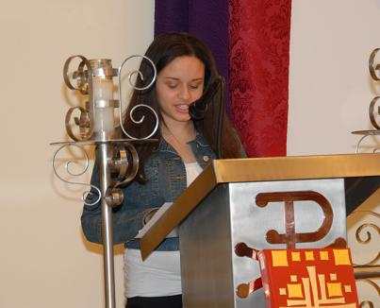
The Liturgy of the Word: First Apologia 67
‘We gather together on Sunday in one place.’
‘The apostles and the prophets are read, as long as time permits.’
‘The president verbally instructs and exhorts.’

Slide 10
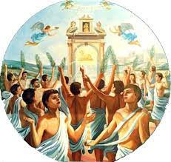
The martyrs of Abitene – 304AD
The Emperor Diocletian prohibited Christians having the Sacred Scriptures, and gathering on Sunday to celebrate the Eucharist.
These martyrs replied: sine dominico non possumus – We cannot survive without Sunday.

Slide 11
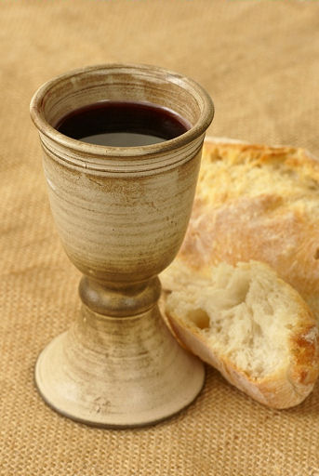
The Liturgy of the Eucharist: First Apologia 67
‘Bread, wine and water are brought.’
‘The president offers prayers and thanksgivings, according to his ability, and the people say Amen.’
‘There is a distribution to each. A portion is sent to those who are absent.’
‘There is a collection for those in want.’

Slide 12
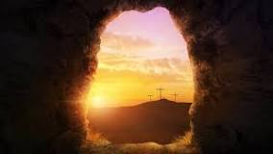
Sunday: Apologia 67
The assembly happens on Sunday.
On the first day of the week God created the light. (Genesis 1)
On the first day of the week Jesus rose from the dead.

Slide 13
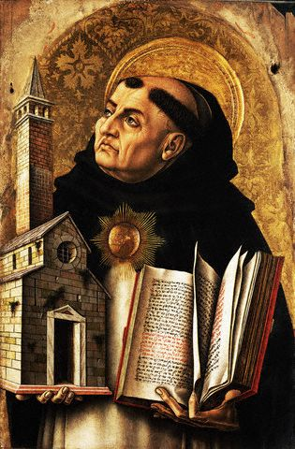
St Thomas Aquinas (1225-1274)
Adoro te devote, latens Deitas,
quae sub his figuris vere latitas
I adore you, hidden God, with devotion
who lie hidden beneath the appearances.

Slide 14
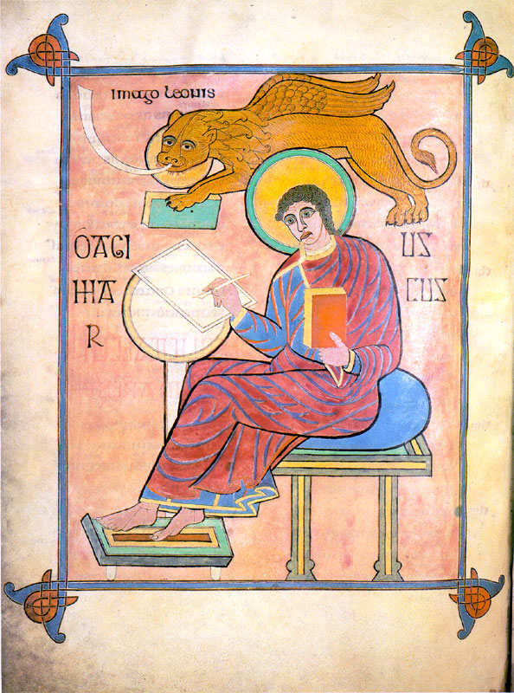
Adoro te devote
Visus, tactus, gustus, in te fallitur,
Sed auditu solo tuto creditur:
Credo quidquid dixit Dei Filius
Nil hoc verbo veritatis verius.
Sight, touch, taste do not work here,
But hearing does: I believe what the Son of God said:
There is nothing more true than his word of truth.

Slide 15
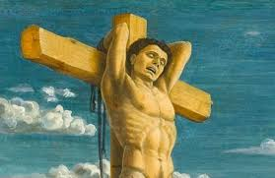
Adoro te devote -
In cruce latebat sola Deitas,
at hic latet simul et humanitas:
ambo tamen credens atque confitens,
peto quod petivit latro poenitens
On the cross your deity was hidden,
but here your humanity is also hidden:
believing in both, that you are God and man,
I ask what the penitent thief asked.

Slide 16
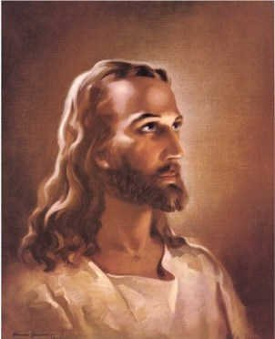
Adoro te devote
Jesu, quem velatum nunc aspicio,
oro fiat illud, quod tam sitio:
ut, te revelata cernens facie,
Visu sim beatus tuae gloriae. Amen.
Jesus, I see you hidden now, but I pray that what I thirst for will come true:
when your face is revealed, may I be blessed by the vision of your glory.

Slide 17
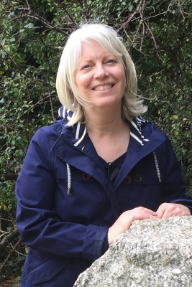
Bread for the world – Bernadette Farrell
‘Bread for the world, a world of hunger,
Wine for all peoples, people who thirst.
May we who eat be bread for others.
May we who drink pour out our love.’
‘Lord Jesus Christ, you are the bread of life…..’
‘Lord Jesus Christ, you are the wine of peace….’

Slide 18
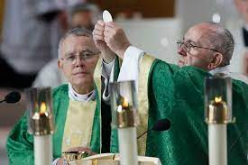
Pope Francis – Desiderio desideravi (2023)
‘We may not even be aware of it, but every time we go to Mass, the first reason is that we are drawn there by his desire for us.’ (n.6)
‘The Church has always protected as its most precious treasure the command of the Lord: Do this in memory of me.’ (n.8)

Slide 19
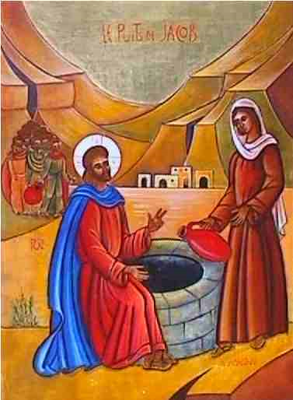
Pope Francis – Desiderio desideravi (2023)
‘I am Nicodemus, the Samaritan woman at the well, the man possessed by demons, the paralytic in the house of Peter, the sinful woman pardoned at the feast, the woman afflicted by haemorrhages, the daughter of Jairus, the blind man of Jericho, Zacchaeus, Lazarus, the thief on the cross, Peter forgiven.’ (n.11)

Slide 20
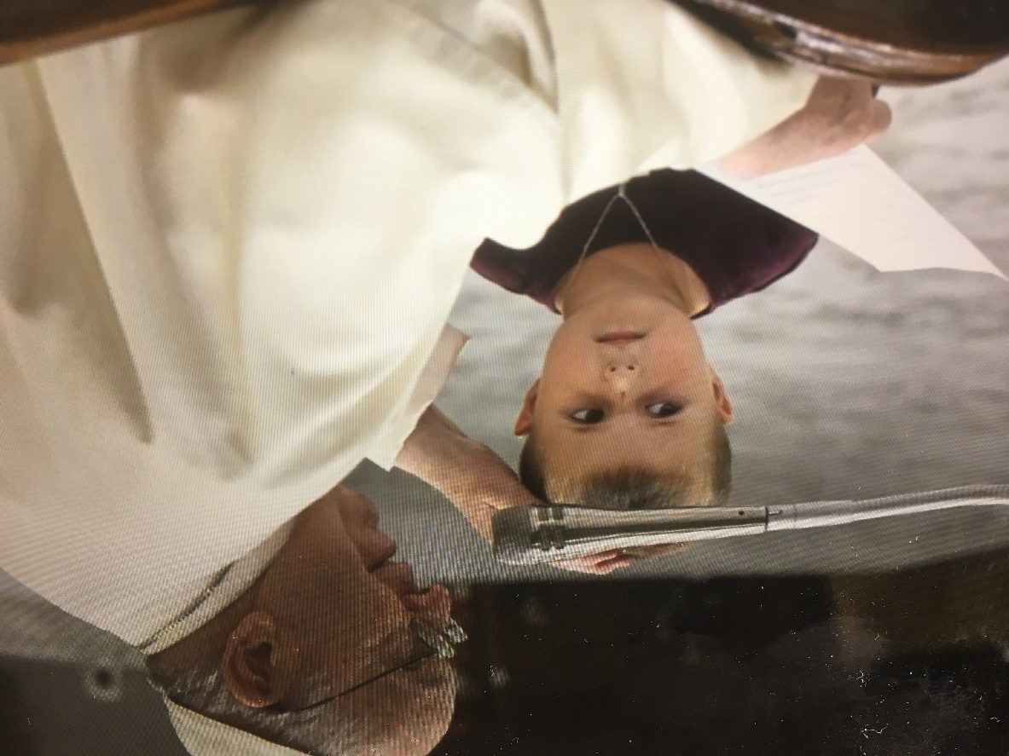
Pope Francis – Desiderio desideravi (2023)
‘The Liturgy takes us by the hand, together, as an assembly, to lead us deep into the mystery that the Word and the sacramental signs reveal to us.’ (n.19)
In the Mass ‘the Church lifts up, in the variety of so many languages, one and the same prayer capable of expressing our unity.’ (n.61)

